Slide 1

MySQL
SWE 322 - Advanced Web Development
Software Engineering Department
College of Engineering and Architecture
Al Yamamah University
Basics
Instructor: Layla Albabtain Fall 2019

Slide 2
Introduction
When connecting to a database, you can use any DBMS (Database Management System), E.g: MySQL, SQL Server..etc.
XAMPP contains phpMyAdmin.
“phpMyAdmin is a free software tool written in PHP, intended to handle the administration of MySQL over the Web.”
For this course, we will use phpMyAdmin to create and maintain our database.

Slide 3
What is MySQL?
MySQL is an open-source relational database management system.
MySQL has its own client Interface.
Each MySQL server can host many databases.
Web application can use its own proprietary database or a standard like MySQL. Example of other standards?!

Slide 4
Creating Tables in phpMyAdmin
We need to create a table to store user’s data.
To enable the user to register and login.

Slide 5
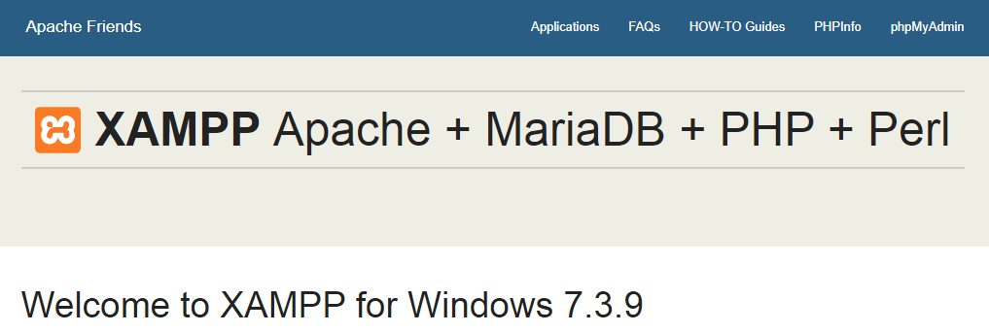
Creating Database
Make sure Xampp (Or mamp or Wamp) are on and MySql and Apache are on.
Open: http://localhost, you should be at this page:
Click on phpMyAdmin

Slide 6
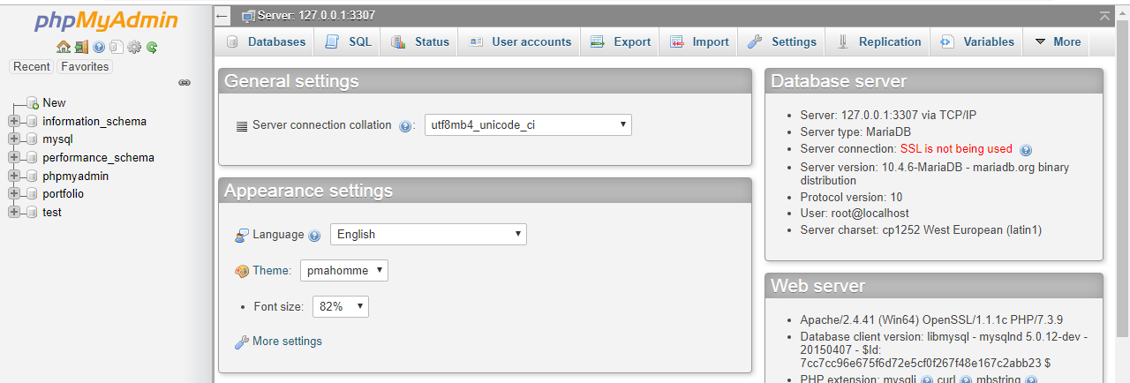
Creating Database

Slide 7
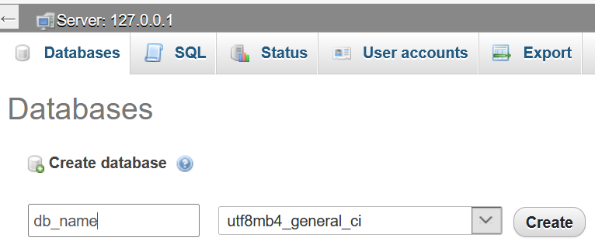
Creating Database
1
2
3

Slide 8
Creating tables within Database

Slide 9
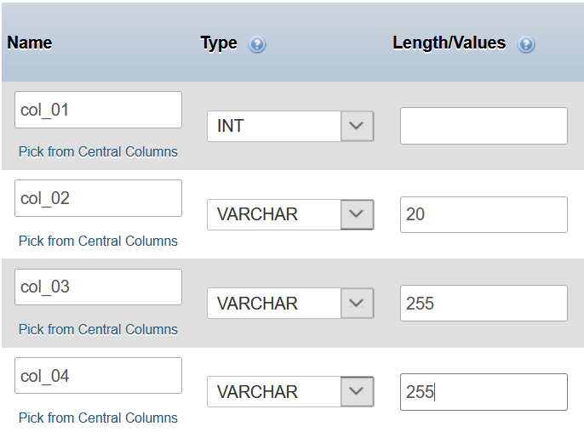
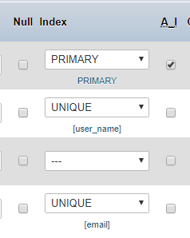
Defining Columns in Tables

Slide 10
Defining Columns in Tables
Each column is a set of a particular data type.
Type can of a column can be:
Int.
Char (Fixed number of characters).
Varchar (Variable length of Characters 0 – Max set length).
Date…etc.
Each column has properties:
Null: Allow this column to be null when creating a row.
A_I: Auto Increment, it means this value will increment each time a row is inserted/created.
Index: define if this column:
A Primary Key (PK).
A Foreign key (FK)
Unique: (no other row should have the same value as another row.

Slide 11
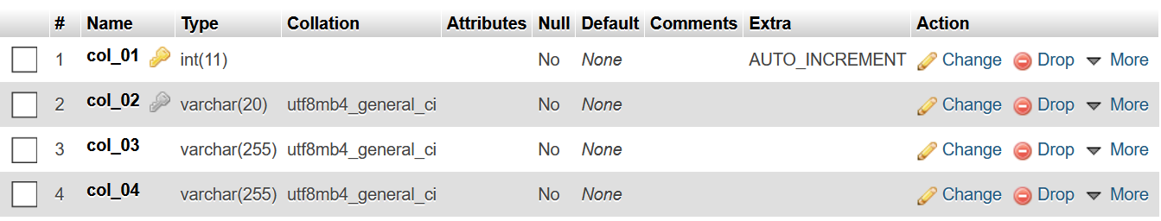
Saving Table
After applying all the options, click on Save. the result will be as follows.

Slide 12
Creating Another Table
Let’s create another table.
Connect both tables using a foreign key (FK).
The FK will the PK from table_01, it will be the column named col_2.3 in table_02.
Table_01 PK is col_01.
Table_02 FK is col_2.3
We will connect both columns.

Slide 13
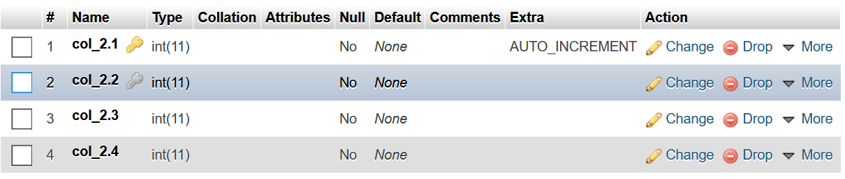
Profile Table

Slide 14
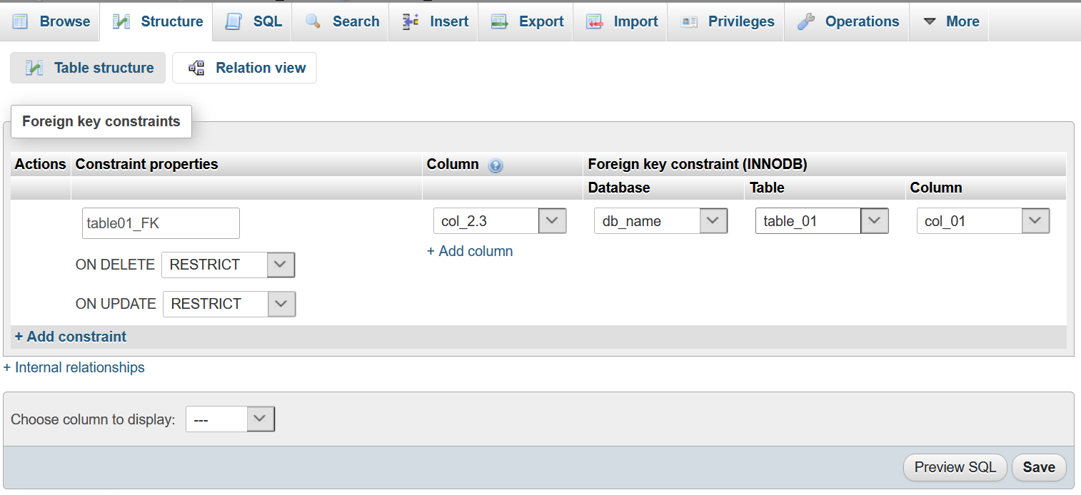
Adding a Foreign Key (FK)
1
2
FK in current Table
Name of other table
Name of Database
PK in the other table

Slide 15
Remember
Important:
You should have a password to log in!
Provide limited access by creating users with limited access to certain databases/tables.
Why?
How?

Slide 16
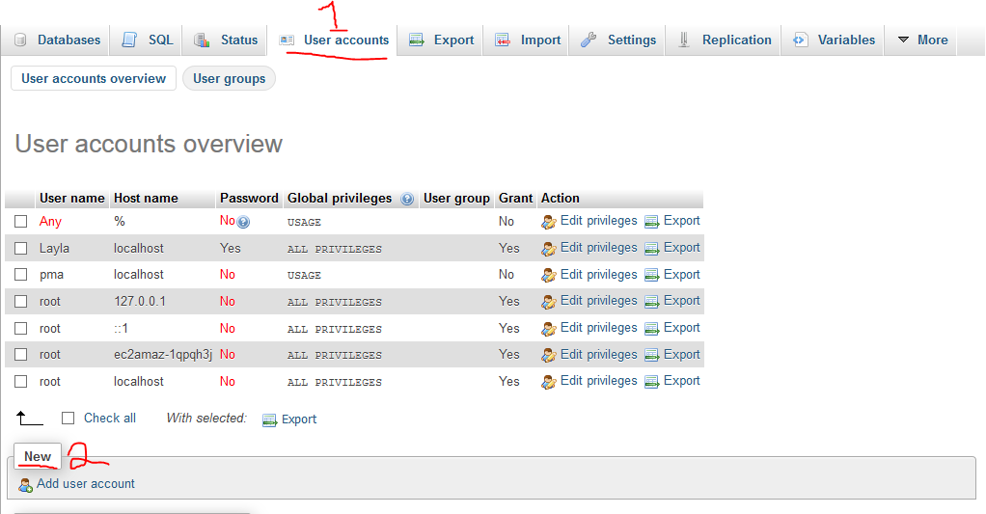
Creating a User and a password

Slide 17
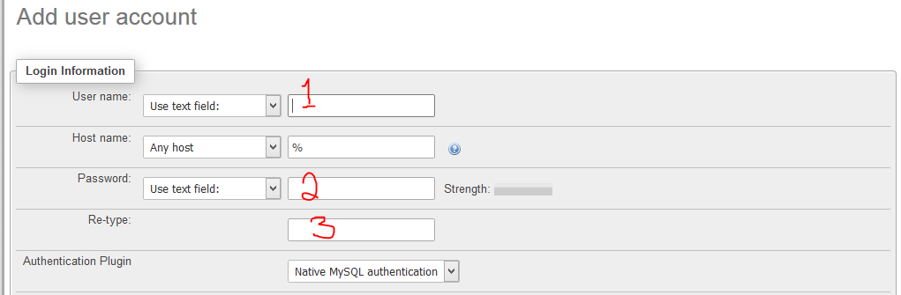
Creating a User and a password

Slide 18
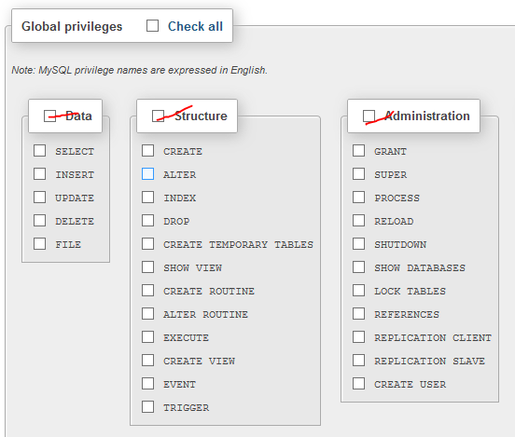
Creating a User and a password

Slide 19
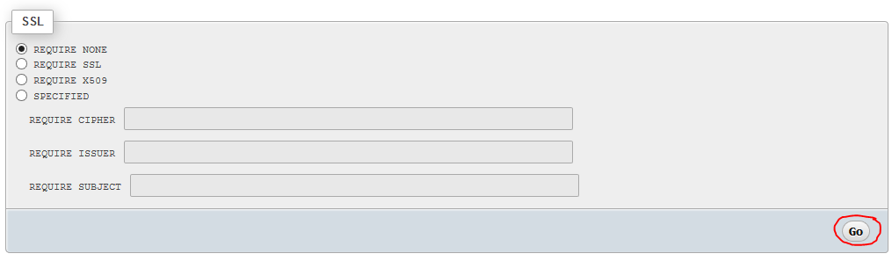
Creating a User and a password

Slide 20
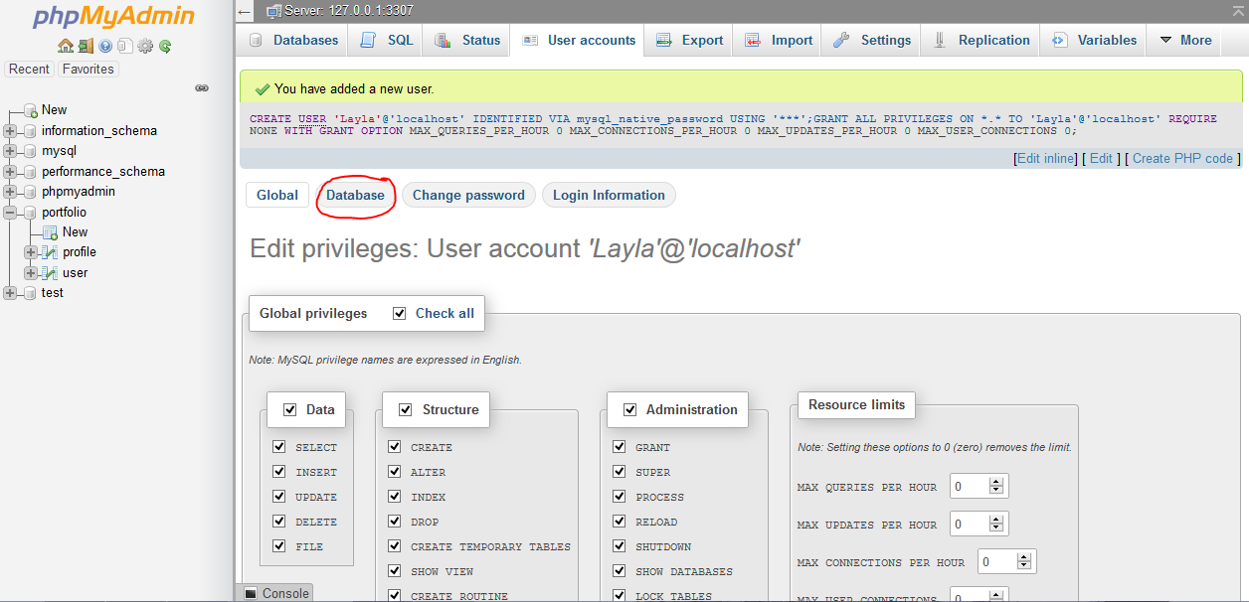
Adding user to Database

Slide 21
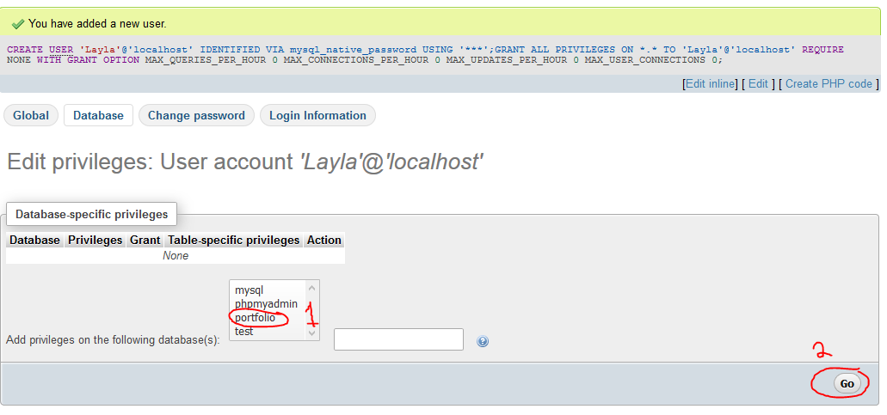
Adding user to Database

Slide 22
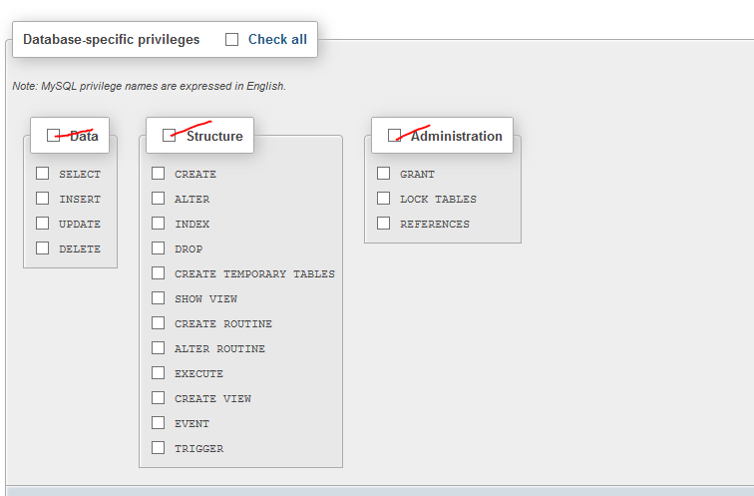
Adding user to Database

Slide 23
Resources
Learning PHP & MySQL Book.

